Slide 1
How to set up pages in AU
Create new pages and add them to Menus

Slide 2
Process Info
Owner name | Annarose Peterson
Team | DnD
Resources | Docebo
Tools
Description | Create and manage pages in AU to create user experiences
 | AU Member | AU Member | AU Member | AU Member | AU Member | AU Member | AU Member | AU Member | AU Member
Date

Slide 3
Steps
Create new page
Edit General Settings
Add Widgets
Add page to Menu

Slide 4
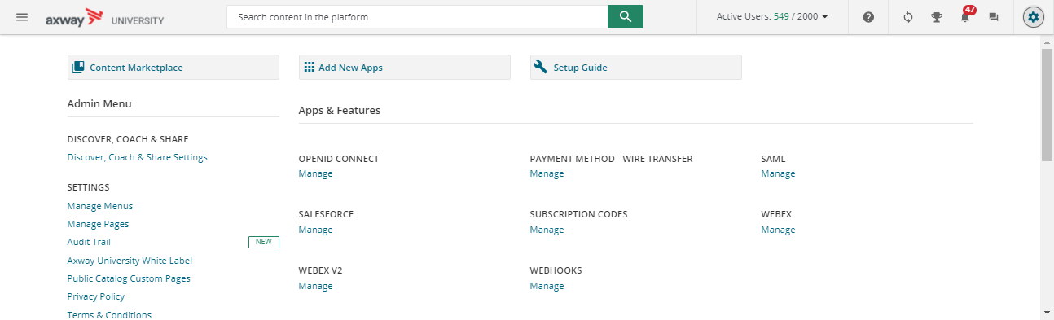
Step 1 – Create page
Access Admin Menu
Select Manage Pages (under Settings section)
1
2

Slide 5
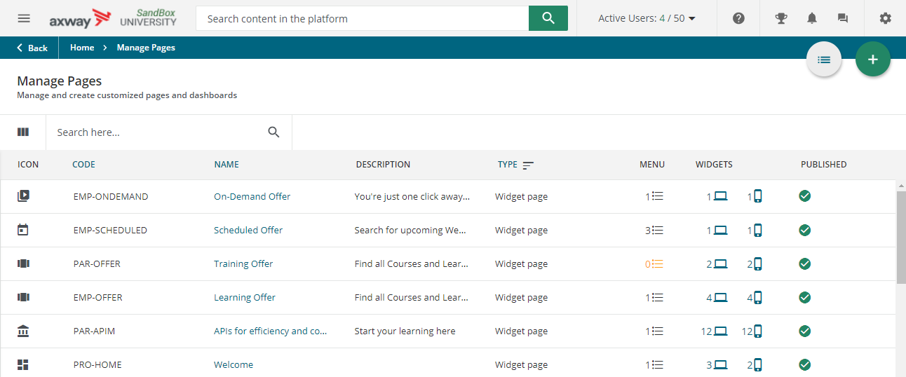
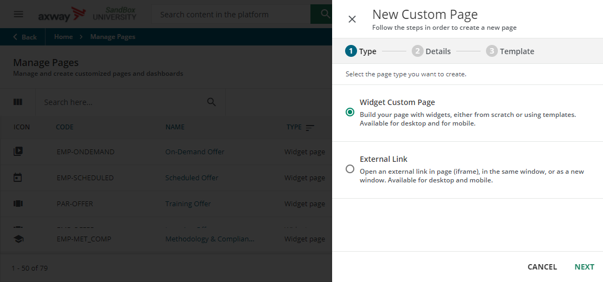

Step 1 – Create page
3
Click Add button
Select Widget Custom Page
Click Next
If you would like to have an external website iframed into AU to appear as a page, select External Link, and then add the Link in the next panel that appears.
4
5

Slide 6
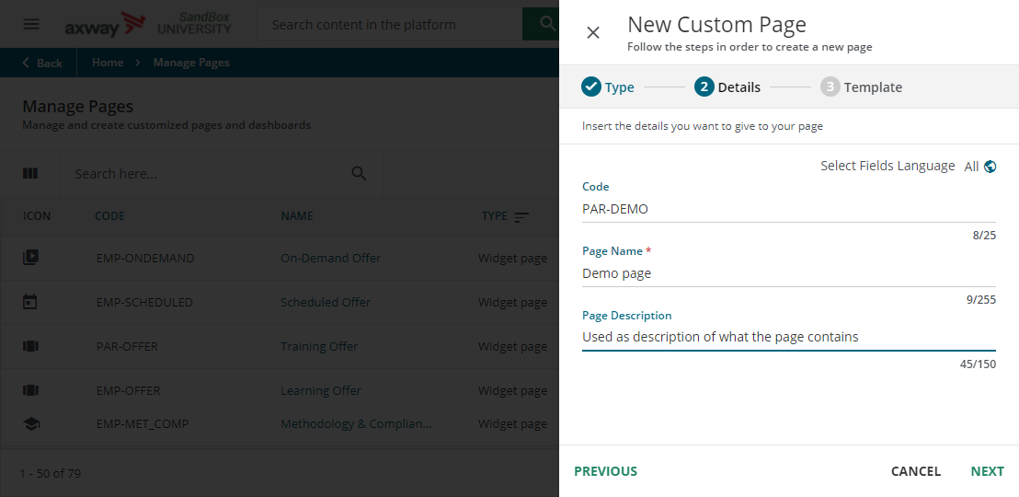
Step 1 – Create page
Add a Code
Add a prefix for the audience type:
“EMP-” for Employee
“CUS-” for Customer
“PAR-” for Partner
“PRO-” for Prospect
Short code to indicate what the page is for (for example: APIM, B2B, COMP)
Add a page name (this is visible to end user so use appropriate naming)
Add a description of what is found on the page (this is also visible to end user)
Click Next
6
7
8
9

Slide 7
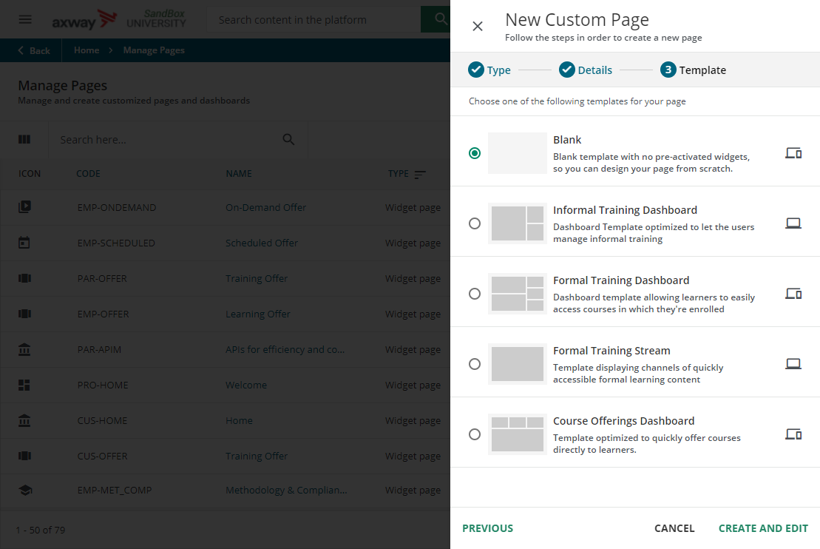
Step 1 – Create page
3
Select a page template
Generally, select blank so that you can add the widgets you want
Click Create and Edit
10
11

Slide 8
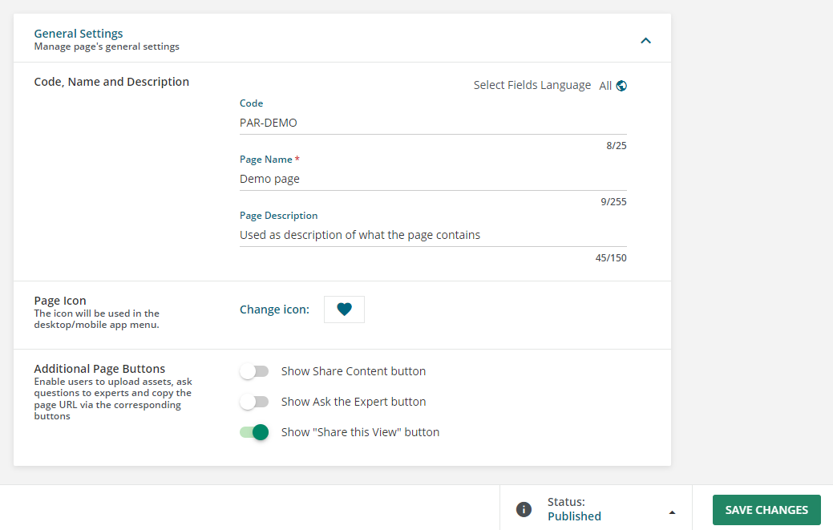
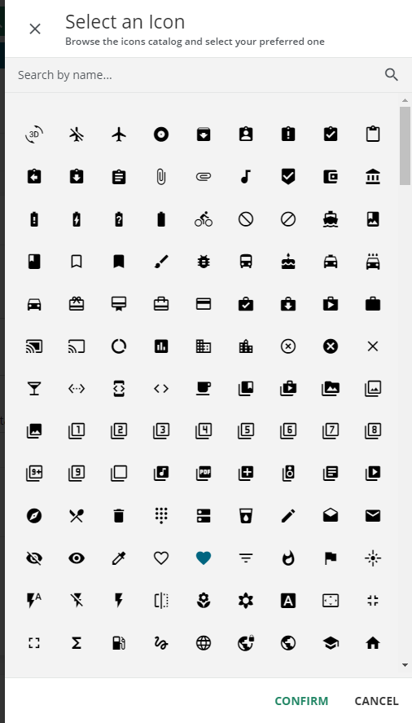
Step 2 – Edit General Settings
1
Expand General Settings section
Change the icon (optional)
Click the icon
Select new icon
Click Confirm
Update additional page options
Show Share content button (toggle off)
Show Ask the Expert button (toggle off)
Share this view (optional can keep on if you choose)
Click Save changes
2a
3
4
2b
2c

Slide 9
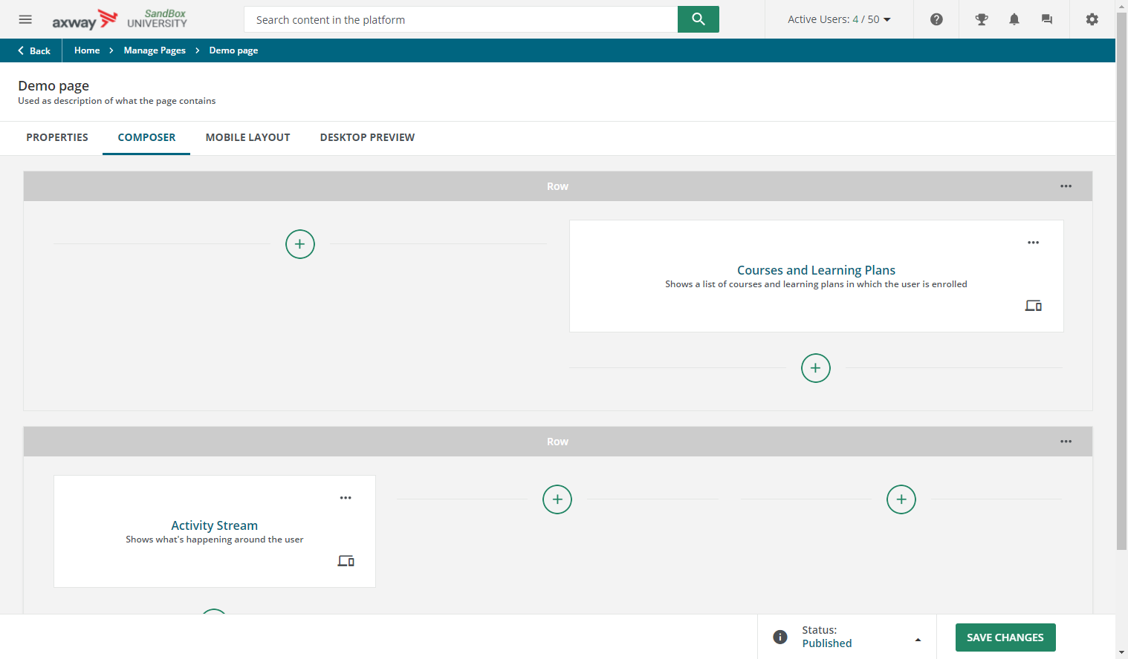
Step 3 – Add Widgets
Row
On the composer screen there are two elements you will work with: Row and Widget
Row – where you organize widget placement and size. Widgets will fit into the space designated by the row.
Widget – the objects that display on the page.
Widget

Slide 10
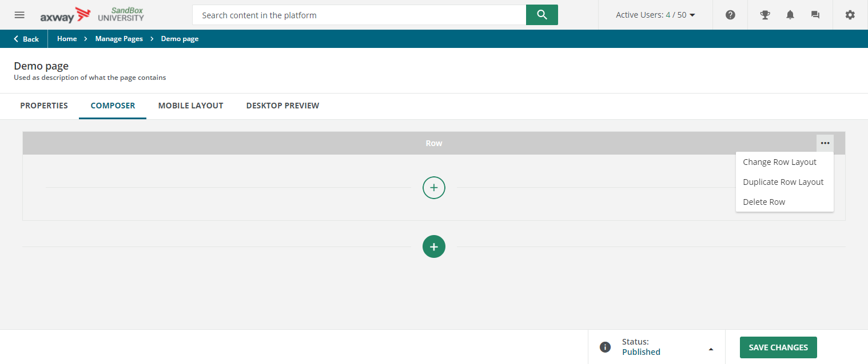
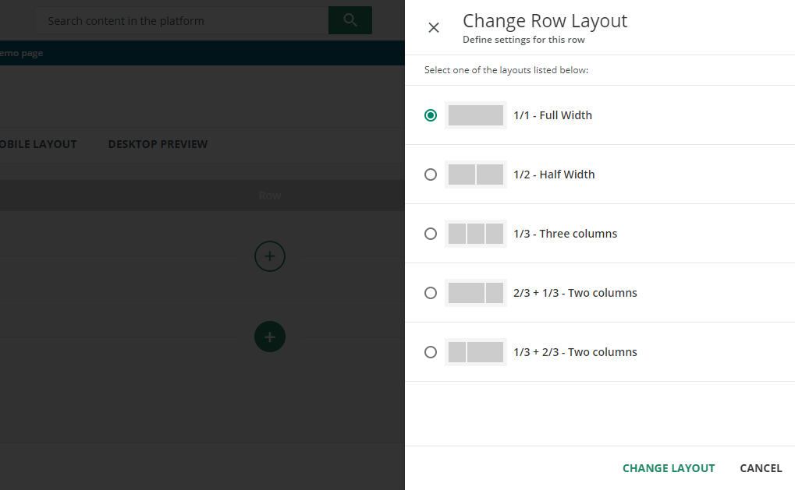
Step 3 – Add Widgets
Editing a Row Layout
Click the ellipsis on Row header
Select Change Row Layout
Select layout
Click Change Layout
Adding a New Row
Click the green plus button on the page under the bottom most row.
1
2
Add Row
3
4

Slide 11
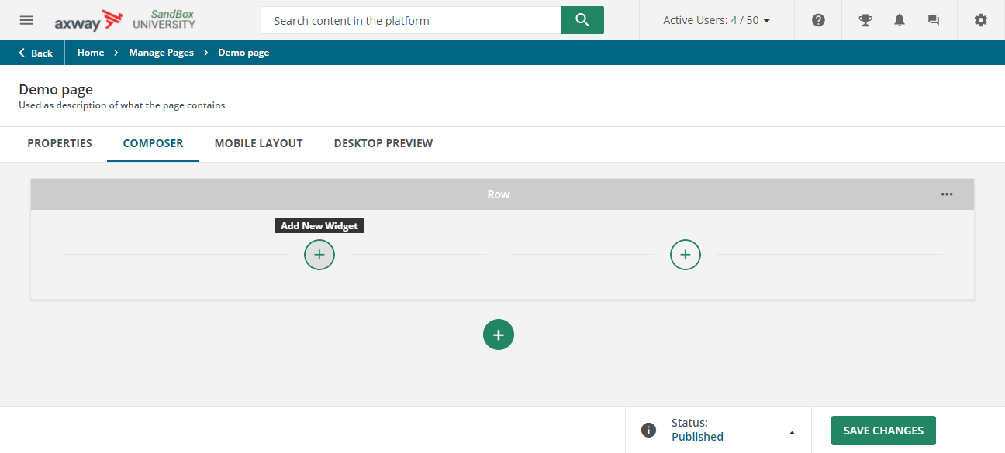
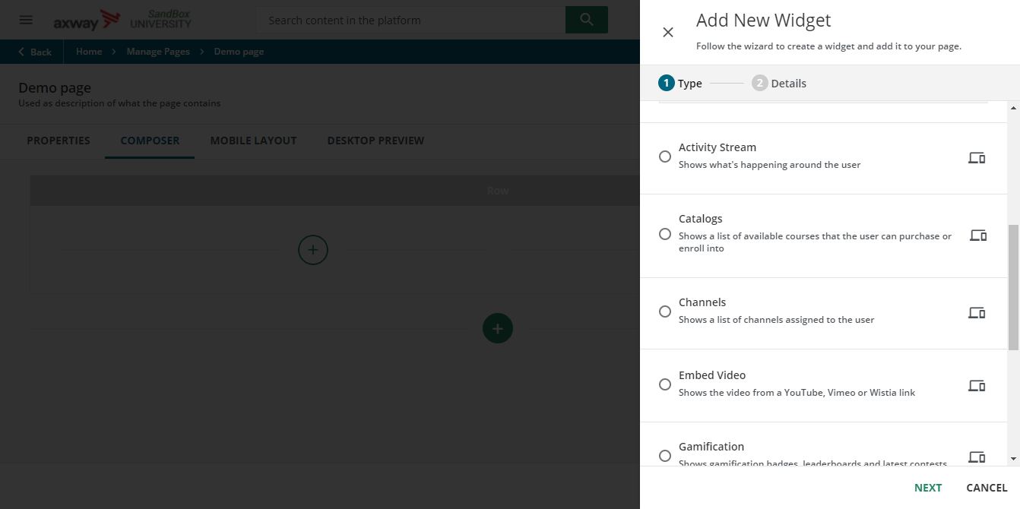
Step 3 – Add Widgets
To add a widget to the page:
Click the Composer tab
Click the add button on the row
Select the widget you want to add
Click next
Edit widget in the panel that displays (each edit panel will be different depending on the widget selected)
a
b
c

Slide 12
Step 3 – Add Widgets (Widget Information)
Each widget has a different use and purpose on the page. For a full listing of what each widget is please refer to this Docebo knowledge article: https://help.docebo.com/hc/en-us/articles/360020127159-List-of-Widgets-for-Custom-Widget-Pages
Widget best practices
Widgets like the Catalog and My courses and learning plans change sizes dynamically, so it is best to not put any widgets below them
To keep a catalog from growing long dynamically, set the catalog display mode to Default or Steam when editing the widget
HTML widget only handles basic HTML, if you want to apply CSS to the HTML, CSS must be added to the Custom Styles section of the Configure Branding and Look page
The CSS applied to an HTML widget will not work from the Page preview, you must view the actual page to see the CSS applied. To learn how to get the URL for a page, go to slide 16

Slide 13
Step 3 – Add Widgets (Widget Information –CONT.)
Widget best practices
For images, it is recommended to use the following widths for each row layout:
Full row: 1329
Half row: 663
Third row: 443
2/3 row: 886
Custom Content widgets – the system will stretch an image (if an image background is being used and it is not big enough) to fit the area of the custom content widget, it is easiest to use a solid color background.
When adding a link for a course/page/catalog view, use a relative link, so that when production is copied to the sandbox, all the links will continue to work in the sandbox.
Normal URL: https://axwayusandbox.docebosaas.com/pages/41/role-based-training-axway?ctl215=field1-_68
Relative URL: /pages/41/role-based-training-axway?ctl215=field1-_68

Slide 14

Step 3 – Add Widgets
While adding widgets to the page:
As you add widgets you can view a preview of the page by clicking the Desktop Preview tab.
When you are ready to make your changes live and to have them appear on the live page (not just the preview) click Save Change
The best way to see the preview of the page, copy the URL of the page and paste it in a new browser tab. This way you can see any CSS changes as well.
1
2
Make sure the page status is Published.

Slide 15
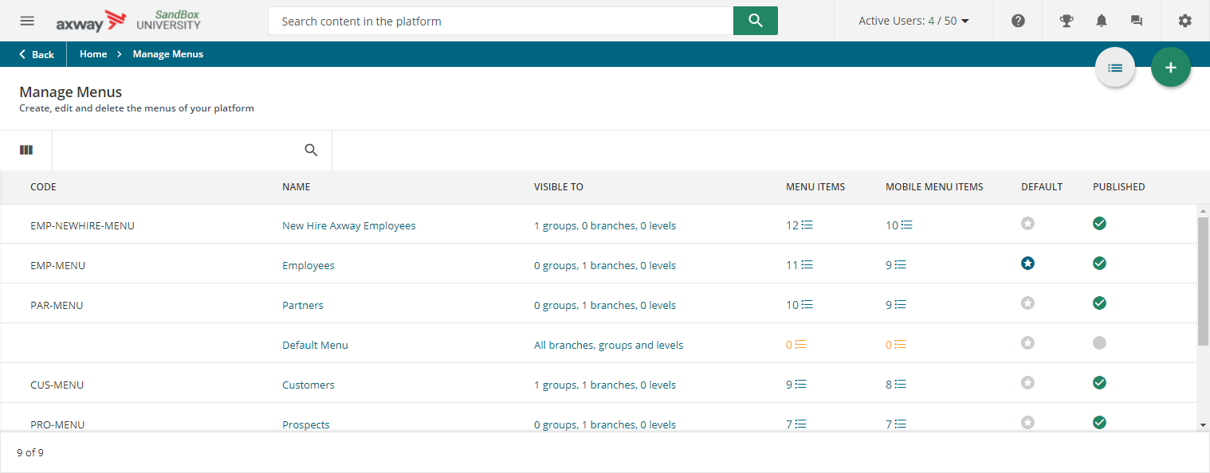
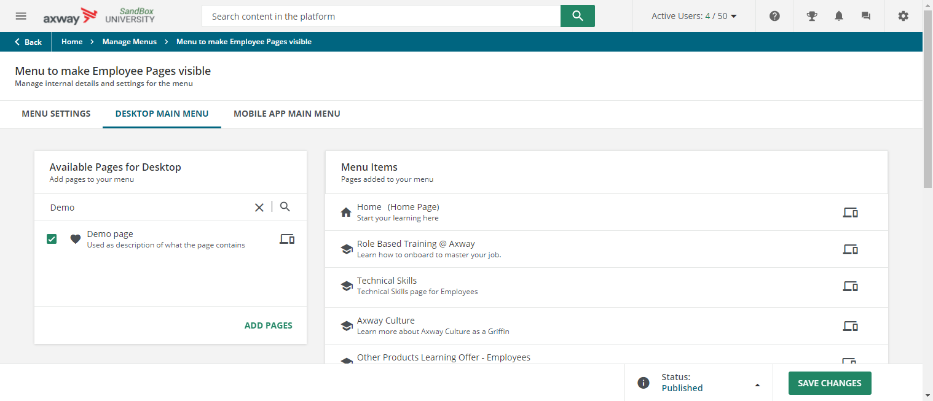
Step 4 – Add Page to Menu
Once your page is finished being created and it is ready to be used, it must be added to a menu. To learn more about the menus being used and which menu your page needs to be assigned to, refer to How to Manage Menus
Follow these steps to add the page to the menu:
Access Manage Menu from Admin menu
Click on the name of the menu
Click the Desktop Main Menu tab
Find and select your page on the “Available for Desktop” area
Click Add Pages
If needed, click and drag the page to arrange it in the correct order on the menu
Click Save Changes
2
3
6
4
5
7

Slide 16
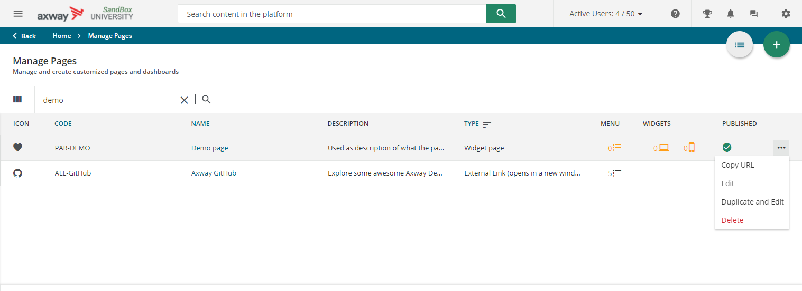
Get URL of a page you are building
Go to Manage pages main page
Locate the page you would like to copy the URL
Click ellipsis (three dots) on row for the page
Select “Copy URL”
You can open a new browser tab paste the URL into the new tab to see live preview of page.
2
3
4

Slide 17
Summary
Create new page or access existing page
Edit General Settings
Add Widgets
Add page to Menu

